Slide 1
7 Top Tips – A full stack ASP.NET MVC5 EF6 Testable application
davemateer@gmail.com
Code and presentation on:
github.com/djhmateer/funny

Slide 2
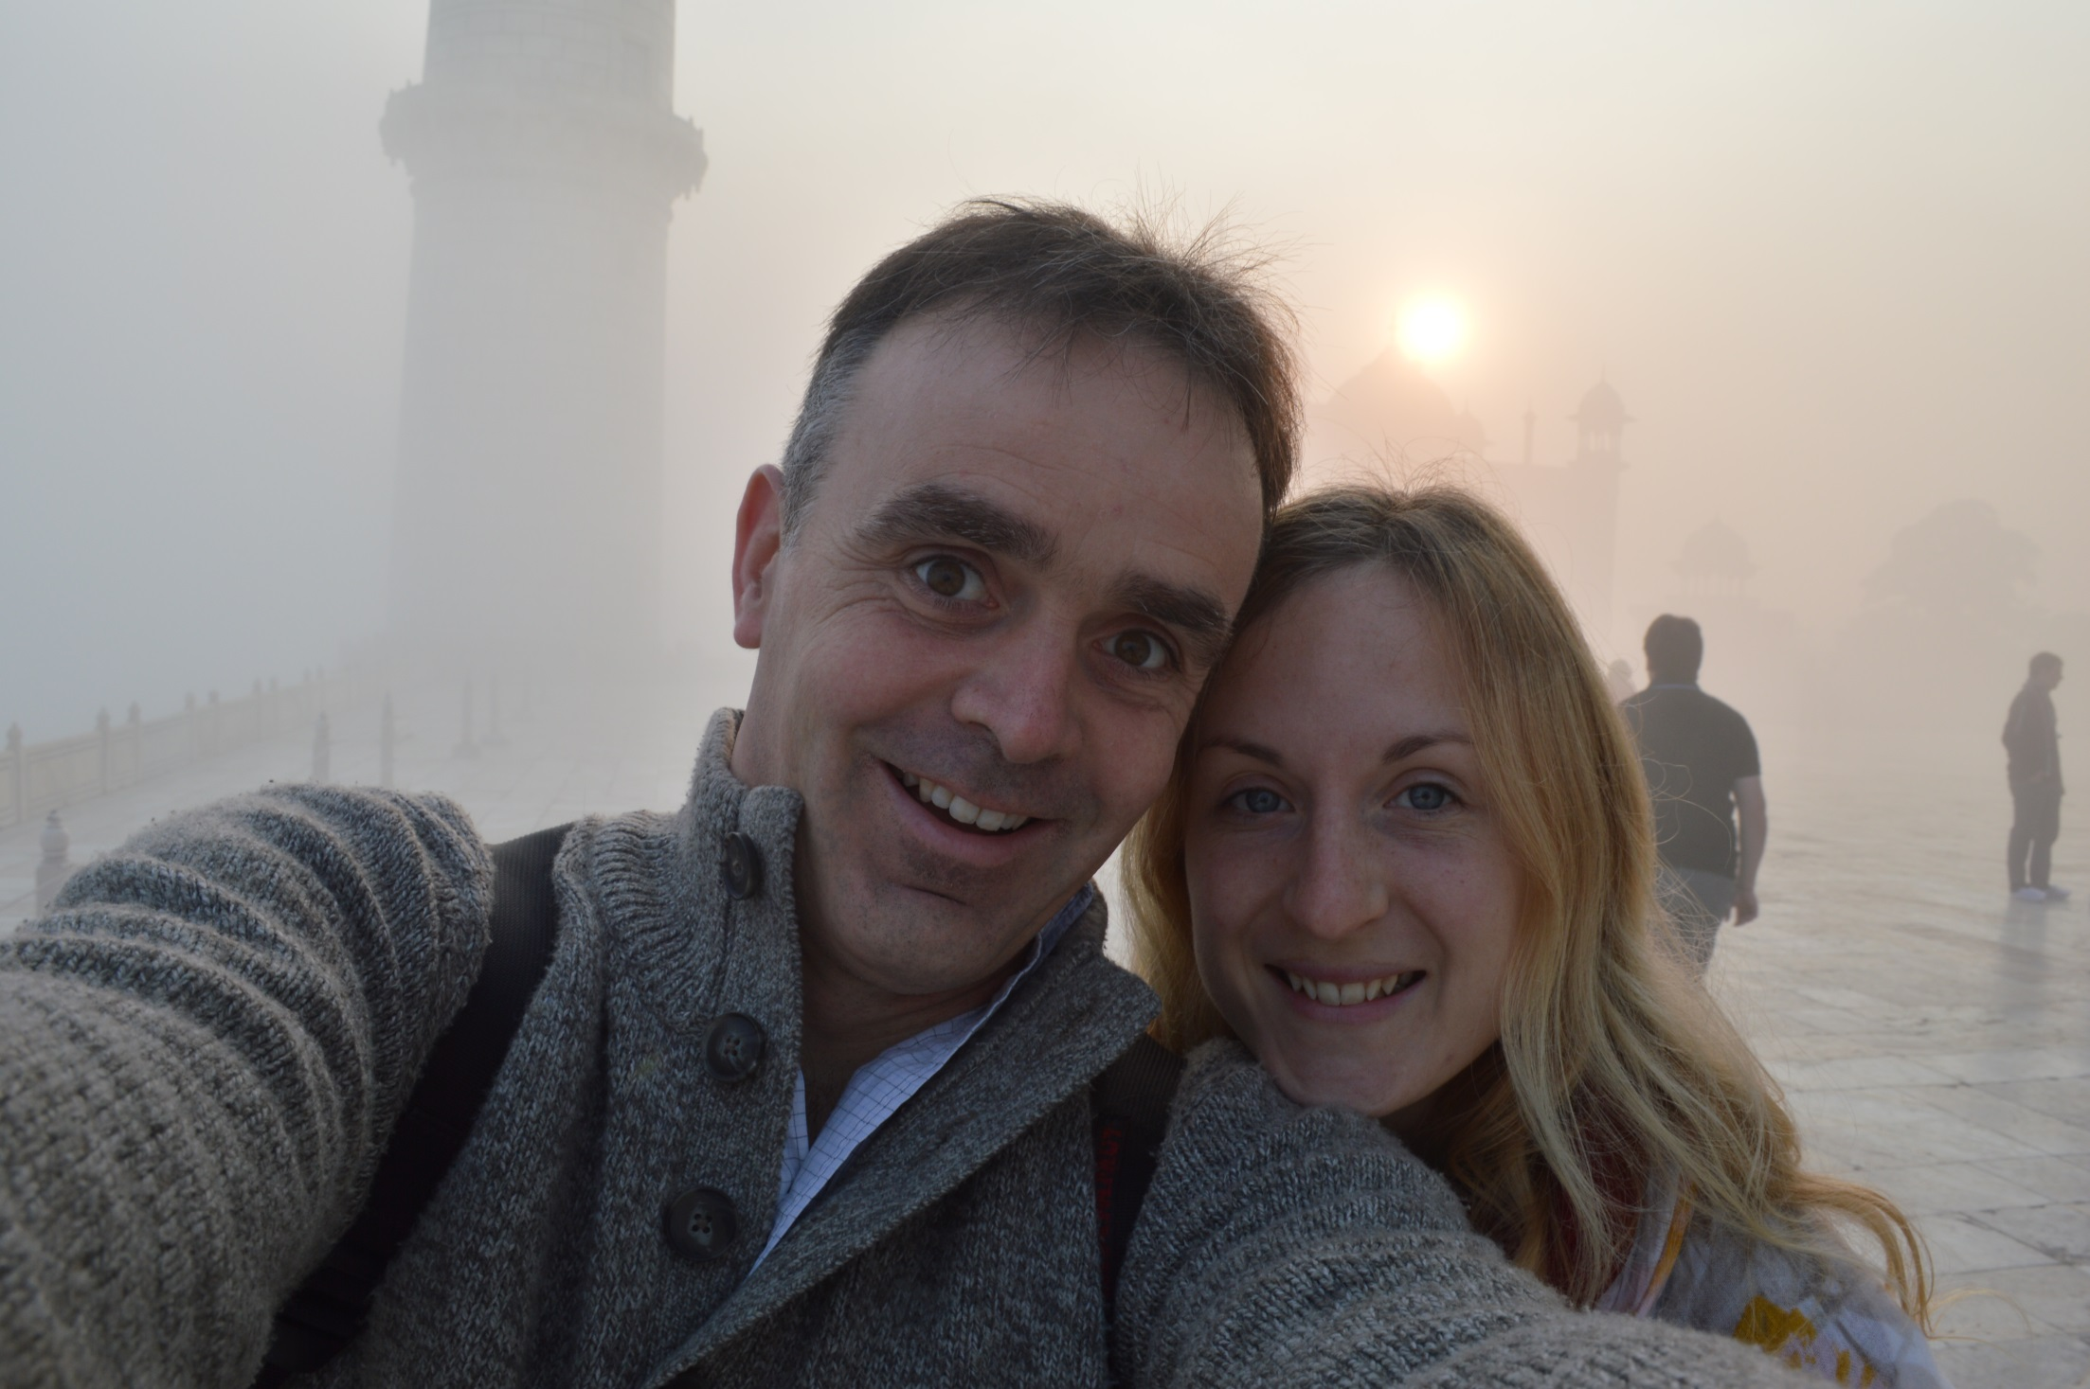
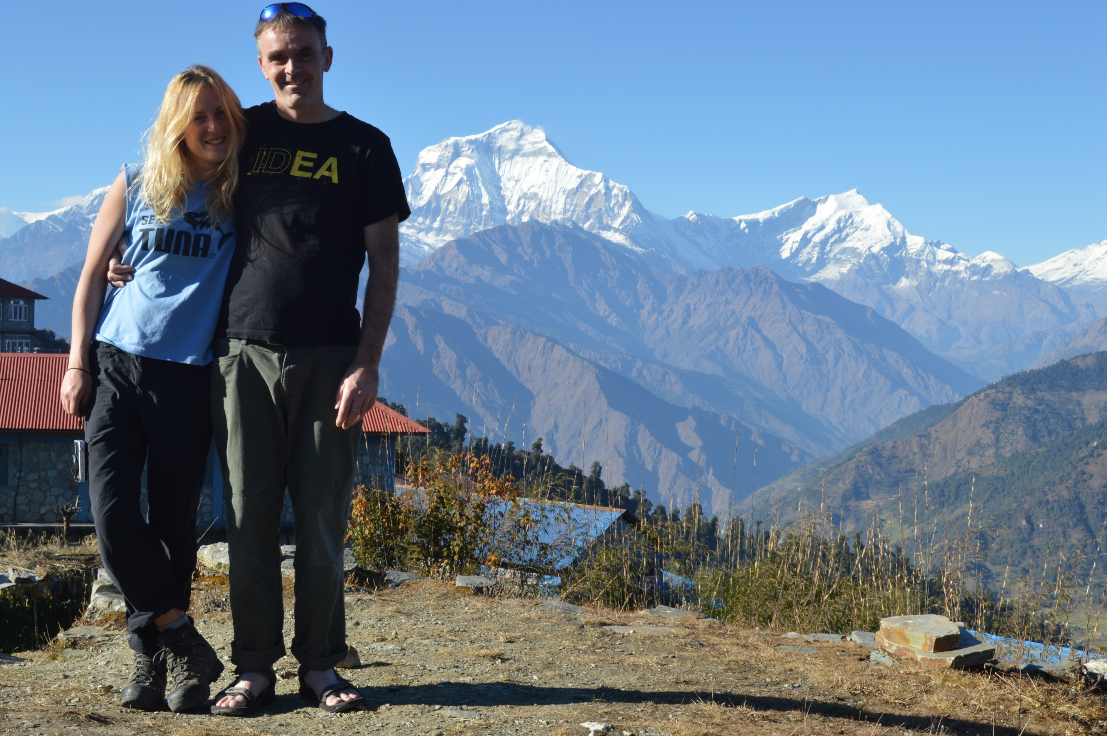
Dave Mateer
Notes:
Dave Mateer – Brought up near Glasgow… lived in New Zealand for 8 years. Now live near Brighton… this isn’t Brighton
Degree is in Mechanical Engineering – worked offshore in Norway in oil business.
Worked as an outdoor instructor in UK, Sri Lanka and did Raleigh expeditions
Got into IT/Software in 1999 – 15 years.
Transitioned into a Dot Net developer since .NET2 days
Worked for small companies in UK, freelancer in Australia for 6 months, and NZ for 4 years..
Now I work for Quorum – Edinburgh based company. 40 people. 10 developers. Major clients are large financial institutions

Slide 3

Employees 40 Person company in Edinburgh Office in Brighton (3 people) Financial Services (banks)
Notes:
Enterprise Apps
Old technology
Hacked together by many many people
Crucial to the business
Throw hardware at solutions to get them to perform (perf usually an issue)
Business logic in SP’s
We come in and try to solve these issues
Over last 15 years I’ve found that most apps I develop are CRUDy – Create Read Update Delete

Slide 4
Context
This is a fun Story!
Not best practice ☺
Opinionated
Magpie coder – have collected lots of shiny things… and now thrown away
Pragmatic.

Slide 5
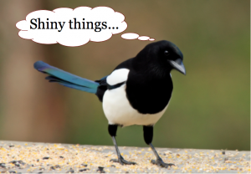
Notes:
The Plan
3 Separate solutions which we’ll review
7 Top tips along the way
Questions (please ask when you think of them)
Enterprise Apps
Old technology
Hacked together by many many people
Crucial to the business
Throw hardware at solutions to get them to perform (perf usually an issue)
We come in and try to solve these issues

Slide 6
Put your hand up if…
Notes:
Who is using ASP.NET MVC in a current work project?
Who has used it in the last 2 years for a work project
Who is here because they thought this session may have good jokes?

Slide 7
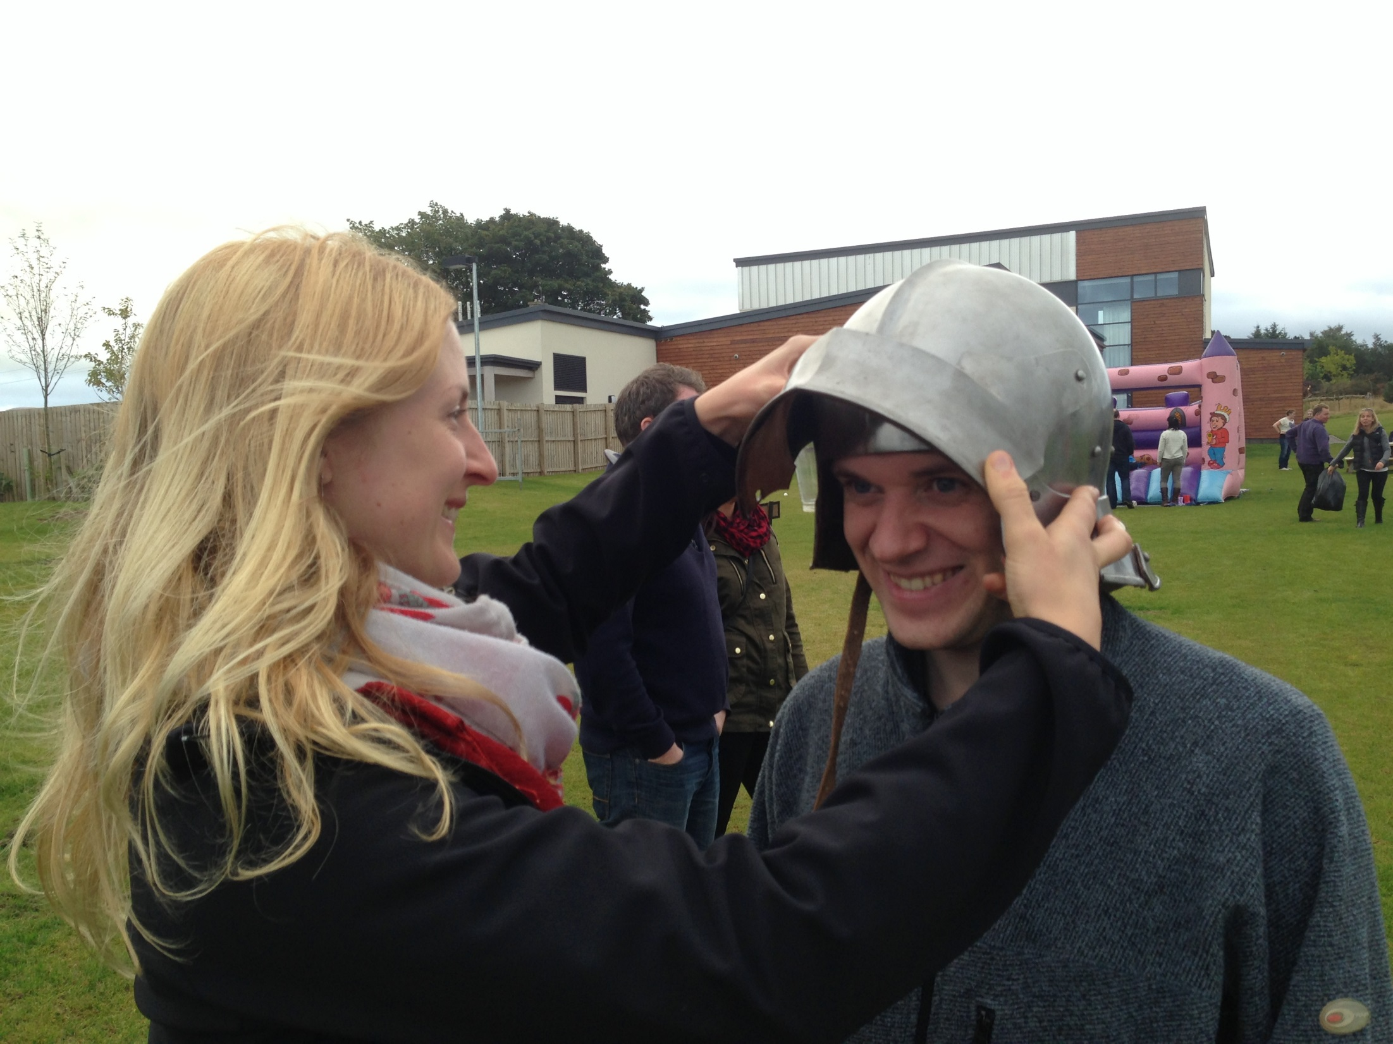
Notes:
Even if you’re a beginner swordsman, or an expert
Good News!!!
There is something here for everyone – the super experts, to the person who wants a new joke… we can always learn something from everyone.
Request – Please stop me if you’re confused, as someone else will be too.
Confession

Slide 8
CONFESSION
Notes:
Con

Slide 9
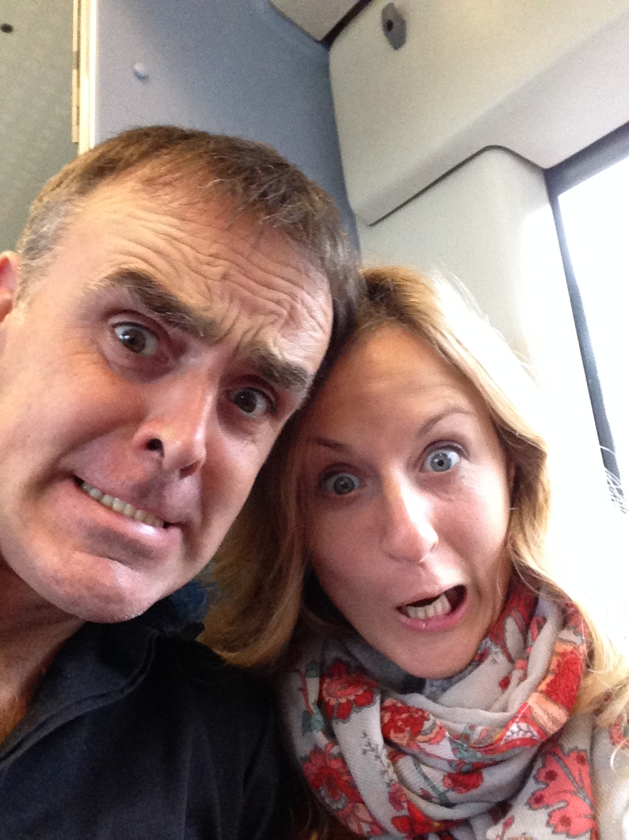

Slide 10
Q: What’s brown and sticky?

Slide 11
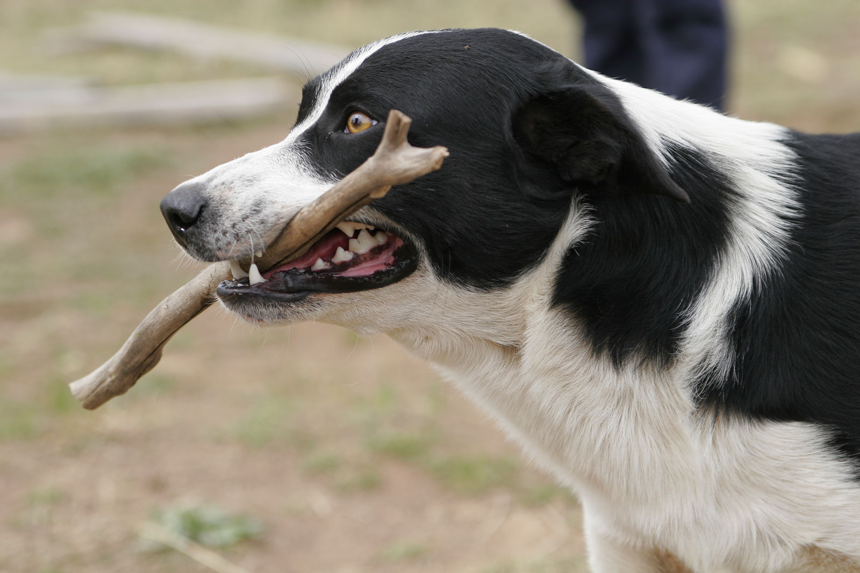
A stick….

Slide 12
File New Project..
Notes:
Launchy – VS2013
Classic Start Menu for Windows 8.

Slide 13
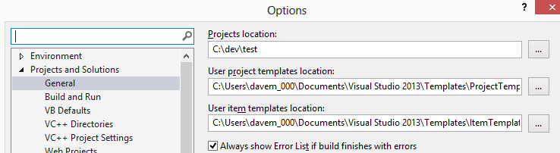
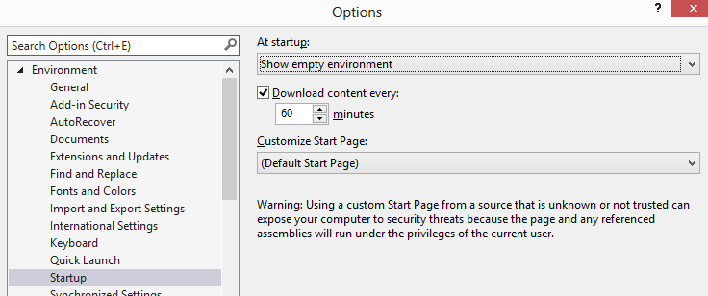
Notes:
Take time to setup your environment –
Projects in a c:\dev - put them on your ssd
Startup fast – empty env (or last opened is good too)
Keyboard shortcuts
ALT F J – open recent
ALT V P – view explorer

Slide 14
What to call the project…?

Slide 15

Notes:
New MVC Project and solution called Dog
View website
Login as a user
View database

Slide 16
Tip 0 Source Control

Slide 17
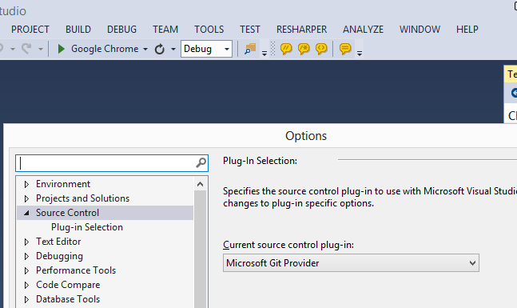
Notes:
Right click – add solution to source control
Do first commit
Github.com
Lastpass – super easy!
Push to github
Sourcetree

Slide 18
Problem?
“Want to remember jokes when I’m out for dinner, so I can make people laugh”
Notes:
Like in developing business apps, I always write down the problem:
Ok that shouldn’t be too hard…
Slam a website together that works ok on my phone, in a weekend and it should be ok!

Slide 19
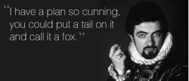
Notes:
Hmm – maybe not.. Lets take this opportunity to play with code…
How about I call it Winter Project and spend a few months playing..
How about I model the project on what I do at work
Enterprisey
ASP.NET MVC (couldn’t get Nancy / Mono etc.. Into these classic institutions)
SQL Server (they’ve usually got it already)
Base it on my experience of what Enterprise apps need to be… ie
KISS
Development vs Maintenance costs.. Up to 80% of a projects costs are in maintenance
Overseas developers
Many developers jump in from 1 to 6 months to make small change
http://stackoverflow.com/questions/3477706/development-cost-versus-maintenance-cost

Slide 20
What I’ve noticed
Notes:
Testing is great – saved my skin so many times..
Simple is great

Slide 21
5 months of coding later… and 2 solutions thrown away..
Notes:
And this is the story of what I’ve learned…over the last 5 months..

Slide 22
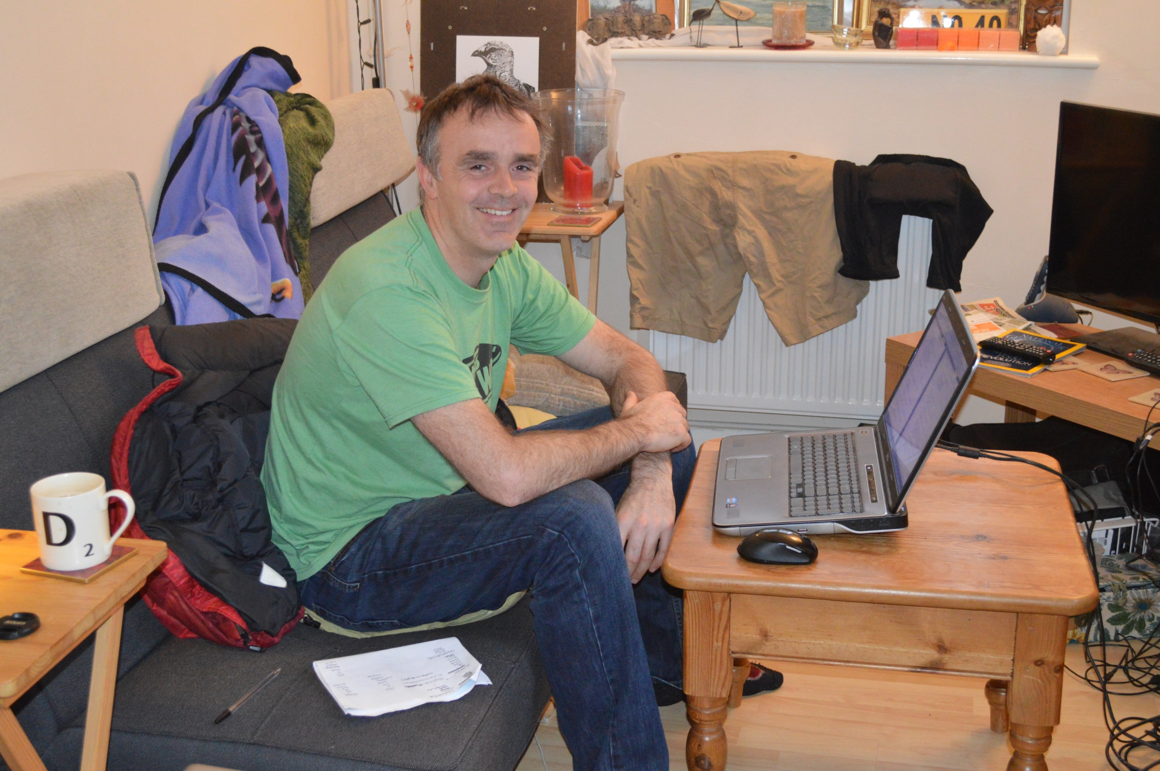

Slide 23
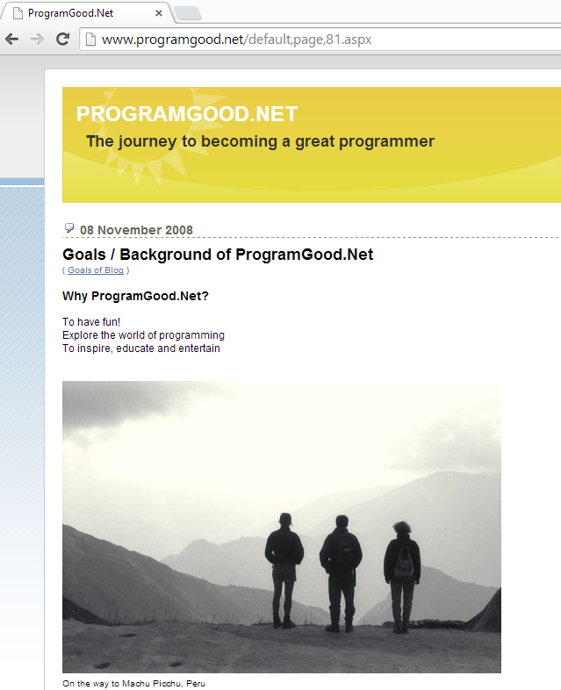
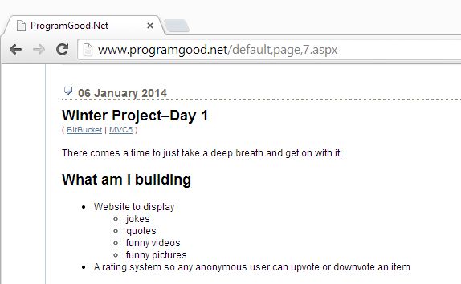
Notes:
So I started a blog about 5.5 years ago
I then though ProgramGood.net was a clever domain name title.
Next slide ->

Slide 24
Notes:
So the blog turned into a dumping ground of my ideas and searchable notes.
Handy
DasBlog is the engine.. Doesn’t use a database. Scott Hanselman was one of the contributors. On a shared webhost for $4 per month I think.

Slide 25
How to improve?
Notes:
Copy others
Pluralsight
Great MVC Sample code
Contoso University
http://www.asp.net/mvc/tutorials/getting-started-with-ef-using-mvc/creating-an-entity-framework-data-model-for-an-asp-net-mvc-application
SutekiShop
MVC3, Nhibernate, Windsor, Nunit, Rhino Mocks

Slide 26
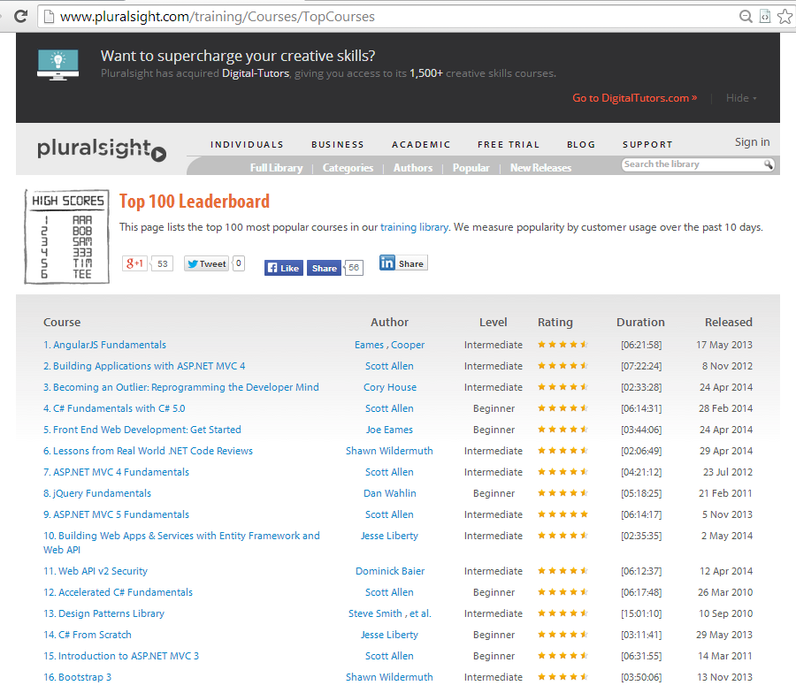
Notes:
K Scott Allen is a great educator!
ASP.NET MVC5 Fundamentals – 6 hours
Building Apps in MVC4 – 7 hours
ASP.NET MVC4 Fundamentals – 4 hours
Intro to MVC3 – 6 hours
nTier – Steve Smith
Testing – Jessie Liberty
DDD – Rob Conery
IoC http://pluralsight.com/training/Courses/Description/ioc-aspdotnet-mvc4
If you’re not a member, 200minutes free trial or look for giveaway tokens for a month.. Or get your work to pay for it recurringly £30 per month
So watched all of these, did lots of reading.. Took about 4 weeks to get something going…
and then Solution number 1 (winter)was like this:

Slide 27
Shiny things…
MVC 5 – New Authorisation model
Seed method
Azure – website free (10 per person)
Glimpse
Caching
PagedList.Mvc
ELMAH (Error Logging Modules and Handlers)
BitBucket (good for private repos for free)
StructureMap
Repository Pattern
Notes:
http://www.programgood.net/2013/12/05/PublishWebsiteSiteToAzureFree.aspx

Slide 28
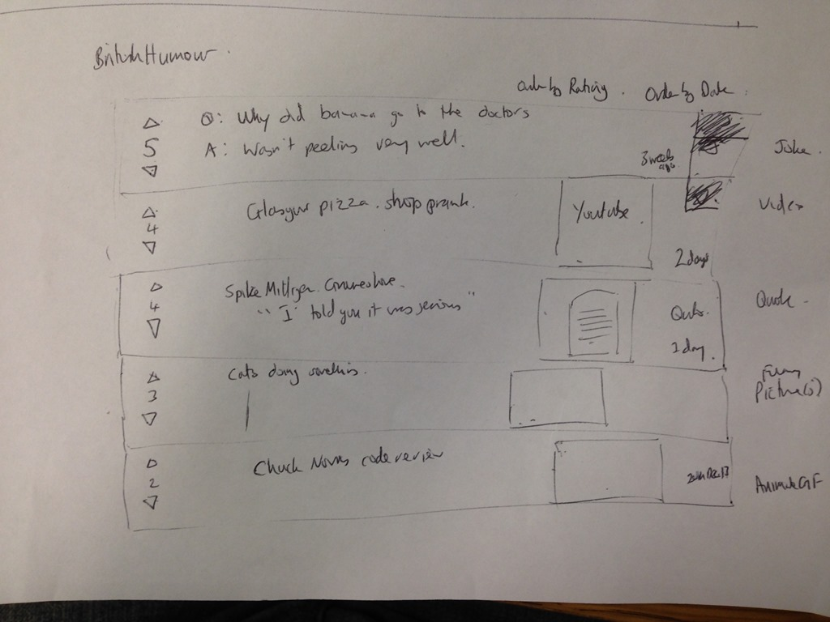
Notes:
http://www.programgood.net/default,page,7.aspx

Slide 29
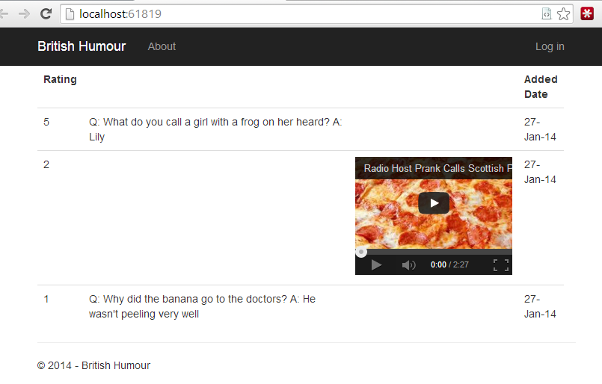
Solution 1 – Winter..TDD Style
Notes:
Inspired by Pluralsight videos and K Scott Allen
Explore code!!!

Slide 30
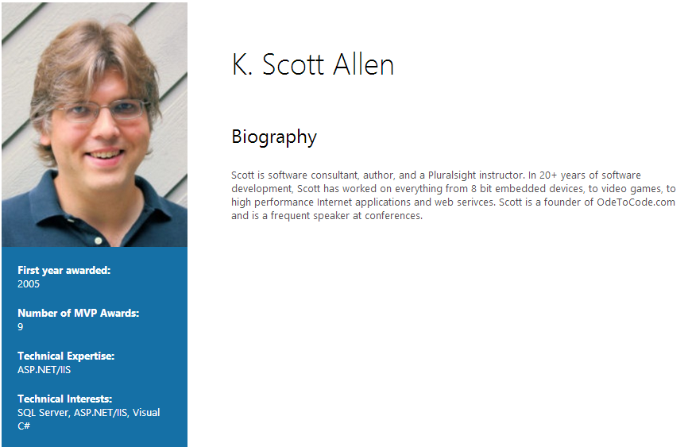
“I have found [testing] to be the most beneficial practice I have ever followed in my career”

Slide 31
Diagram of Project on 1 slide

Slide 32
Show project1 - winter
Notes:
Show code from Top
View
Controller
WinterDb (Irepo<T>)
Model – Story
Tests – StoryControllerTests..
given a valid story
given invalid story
TDD style – from point of view of what the application should do
Complexity – IoC..broken somewhere..

Slide 33
Tech Used in Solution 1
Winter.Web.Tests naming style
Unity.Mvc5 for IoC
Generic Repository<T>
Unit tests with FakeWinterDb
2 Projects – tests and web
EF6 Code First and migrations
Notes:
Starts of page 11 http://www.programgood.net/default,page,10.aspx

Slide 34
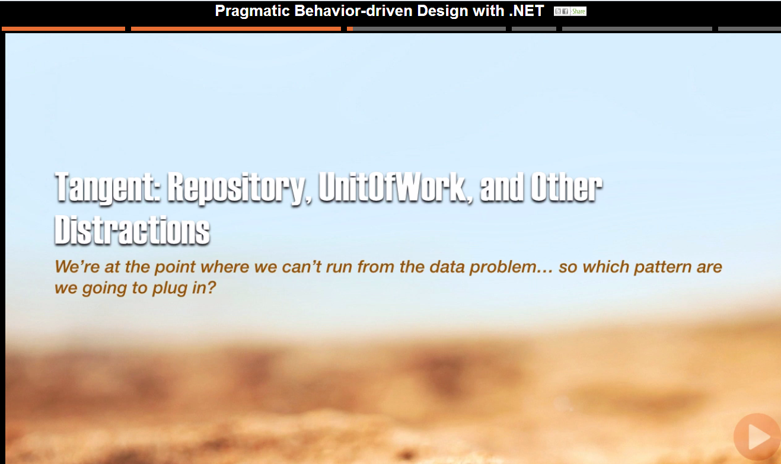
Notes:
Zeal and opinion is coming up!
- Rob Conery’s summary here

Slide 35
Unit Of Work
Create a “Context” or “Session”
Get objects from or add object to the session
Save the changes to the session transactionally when you are done

Slide 36
Repository
An object that contains explicity, transactional methods which return data or execute a command
Eg repo.GetUser(ID)
Notes:
CQRS – Udi Dahan and Greg Young
Separate queries and commands

Slide 37
Problems
UoW – single instance of a session with large app with many objects.. Single session early..ie on controller.
Repo – Spiralling methods.. Eg GetOrdersByCustomer, GetOrdersByCustomer

Slide 38
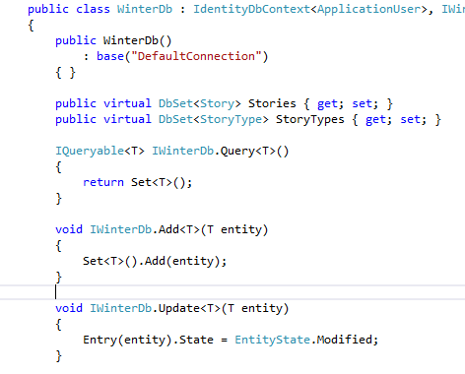
UoW and IRepository<T>
Defeats the purpose of both
Doubles abstraction
Notes:
Breaks idea of repository as works on a single class
Not transactional..repo methods should be atomic
- allows flush of UoW
Iqueryable so can tweak query with where clauses..breaks repo encapsulation
- extra layer of abstratcion

Slide 39
Review of Solution 1
Good
Bad
Simple(ish)
Didn’t feel Enterprisey
Wasn’t happy with validation
Do I need IoC yet?
Complexity for the sake of it..?
Why do I need IRepository<T>?

Slide 40
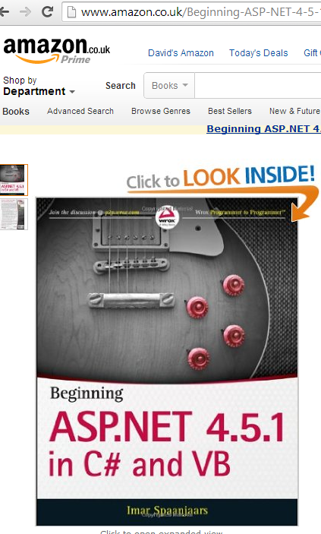

Solution 2 - nLayers
MVP Since 2008
Awesome 10 part tutorial

Slide 41
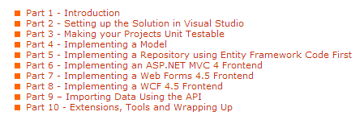
Very extensive 10 part tutorial using
Notes:
http://imar.spaanjaars.com/
Can buy the pdf – in c:\dev

Slide 42
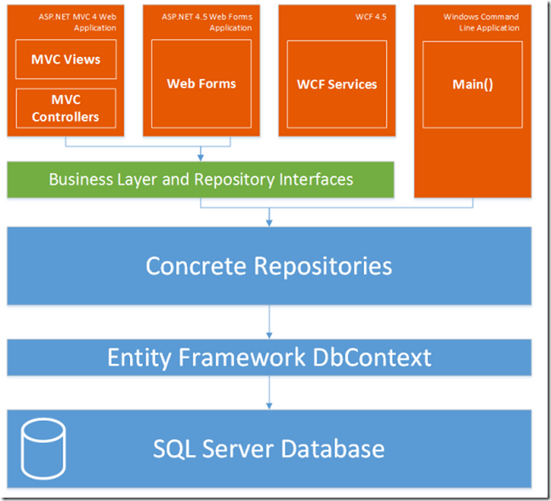

Slide 43
Own diagram here
Notes:
Start at top of solution
View
AutoMapper

Slide 44
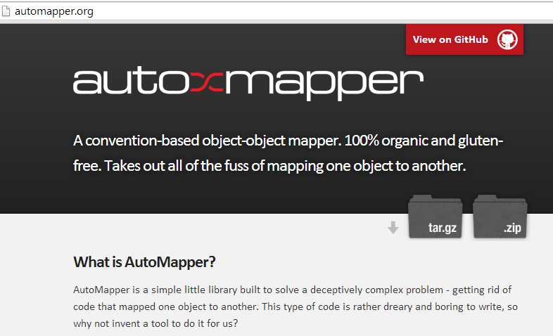
Notes:
Show simple code example here

Slide 45
Ninject (and StructureMap) for IoC
Domain Entities
Value Objects

Slide 46
Why Use N-Layers
Testability
Separation – make it easier to find where things are in large projects eg dataaccess, business logic, UI
Reuse – eg a console app can use all the goodness of the main MVC app
Previous Versions
BLL/DAL – lots of pass through code
DAL tight coupling making hard to test
SP’s hard to maintain and test
Validation was custom – now have better ways

Slide 47
Review of nlayers
Good
Bad
Abstractions make easier for larger apps
Complex
Complex
Complex
Never made it to production

Slide 48
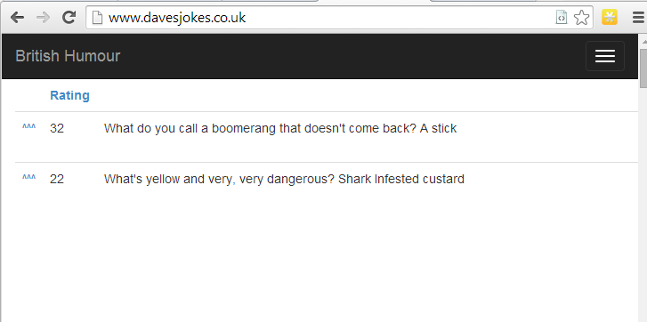
Project 3 - Funny
Please go to: www.davesjokes.co.uk
Notes:
Have a play – some good jokes on here ☺

Slide 49
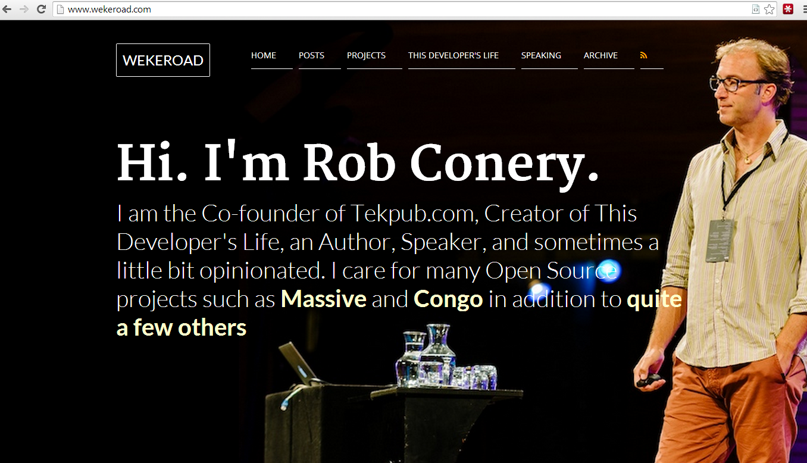

Slide 50
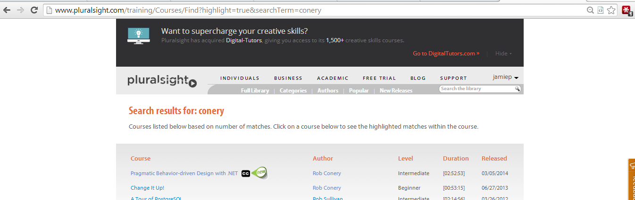
Notes:
Inspired by Rob Conery’s talk on BDD on pluralsight

Slide 51
Own Diagram here

Slide 52
Review of Project 3
Good
Bad
Simple
Tests are easy
Gave what the customer wanted fast

Slide 53
Tip 1 - Drive out from Tests
Why is this good?
“Start with the customer and work backwards”

Slide 54
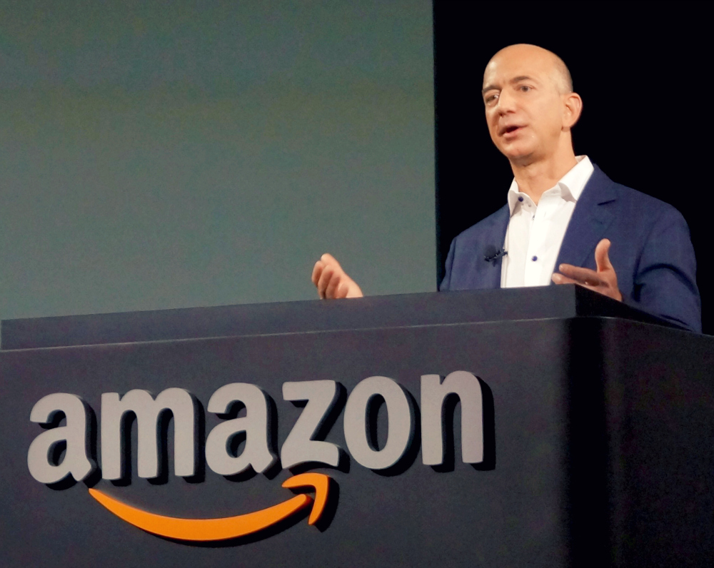
Notes:
Jeff Bezos – CEO of Amazon

Slide 55
What Does Customer Want?
Easy to remember URL
Show all Jokes on 1 page
Default to highest rating first
Can see most recently added Jokes
Be able to anonymously vote for a Joke
Be able to CRUD jokes as an admin
Easy maintainable system can hand over to another developer

Slide 56
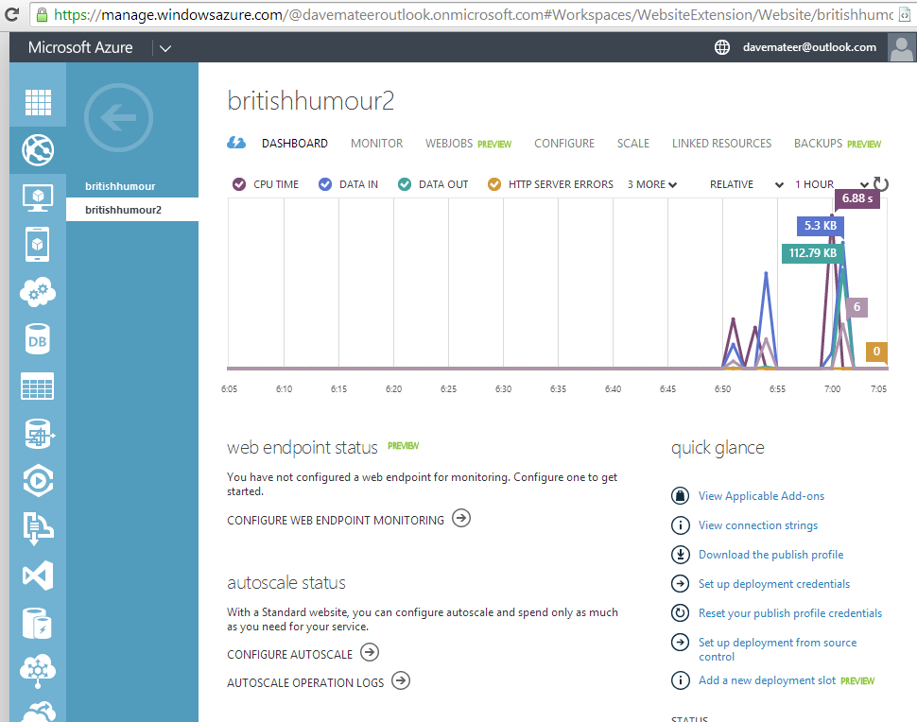
Tip 2 – Get working in production environment
Azure support in VS2013

Slide 57
Tip 2.5 – Diagrams help me

Slide 58
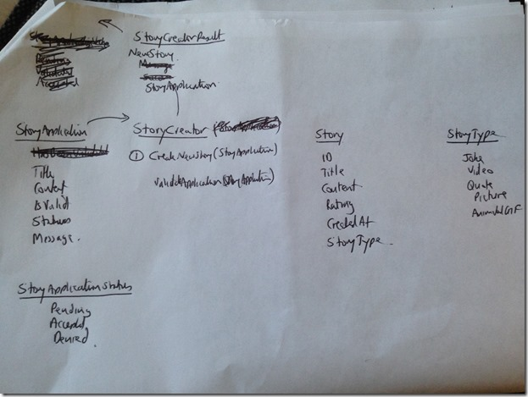

Slide 59
End Result!
www.davesjokes.co.uk
Try to view the site
And upvote a joke or 2
You may see some validation happening ☺

Slide 60
Tip 8 The Most Important Thing I’ve discovered….

Slide 61
Enjoy Programming!
Notes:
Ok but how…. I’m working in VB.NET on VS2005 for my day job, on a windows XP VM with 756MB of RAM…. Using ClearCase source control…???!!!!

Slide 62
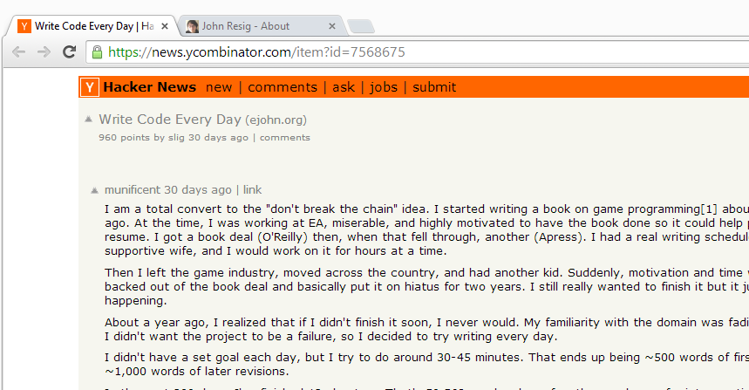

How?
Notes:
Started getting up early… 5:45am seems okay for me. 6am-7:30am code
Take Ellie a cup of tea in bed!
Don’t check emails
Just try to code on your fun project

Slide 63
Hacker News….
Notes:
Great news site – article on ‘coding every day’

Slide 64
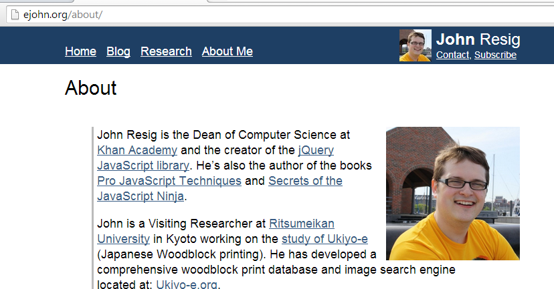
jQuery guy..
Notes:
Great news site – article on ‘coding every day’

Slide 65
Coding every day..
Notes:
Last fall, work on my coding side projects came to a head: I wasn’t making adequate progress and I couldn’t find a way to get more done without sacrificing my ability to do effective work at Khan Academy.
There were a few major problems with how I was working on my side projects. I was primarily working on them during the weekends and sometimes in the evenings during the week. This is a strategy that does not work well for me, as it turns out. I was burdened with an incredible amount of stress to try and complete as much high quality work as possible during the weekend (and if I was unable to it felt like a failure). This was a problem as there’s no guarantee that every weekend will be free – nor that I’ll want to program all day for two days (removing any chance of relaxation or doing anything fun).
There’s also the issue that a week between working on some code is a long time, it’s very easy to forget what you were working on or what you left off on (even if you keep notes). Not to mention if you miss a weekend you end up with a two week gap as a result. That massive multi-week context switch can be deadly (I’ve had many side projects die due to attention starvation like that).
Inspired by the incredible work that Jennifer Dewalt completed last year, in which she taught herself programming by building 180 web sites in 180 days, I felt compelled to try a similar tactic: working on my side projects every single day.

Slide 66
Stand on Shoulders of Giants
Notes:
Last fall, work on my coding side projects came to a head: I wasn’t making adequate progress and I couldn’t find a way to get more done without sacrificing my ability to do effective work at Khan Academy.
There were a few major problems with how I was working on my side projects. I was primarily working on them during the weekends and sometimes in the evenings during the week. This is a strategy that does not work well for me, as it turns out. I was burdened with an incredible amount of stress to try and complete as much high quality work as possible during the weekend (and if I was unable to it felt like a failure). This was a problem as there’s no guarantee that every weekend will be free – nor that I’ll want to program all day for two days (removing any chance of relaxation or doing anything fun).
There’s also the issue that a week between working on some code is a long time, it’s very easy to forget what you were working on or what you left off on (even if you keep notes). Not to mention if you miss a weekend you end up with a two week gap as a result. That massive multi-week context switch can be deadly (I’ve had many side projects die due to attention starvation like that).
Inspired by the incredible work that Jennifer Dewalt completed last year, in which she taught herself programming by building 180 web sites in 180 days, I felt compelled to try a similar tactic: working on my side projects every single day.

Slide 67

Notes:
Sleep less
Can focus more at work
Less tired in evening

Slide 68
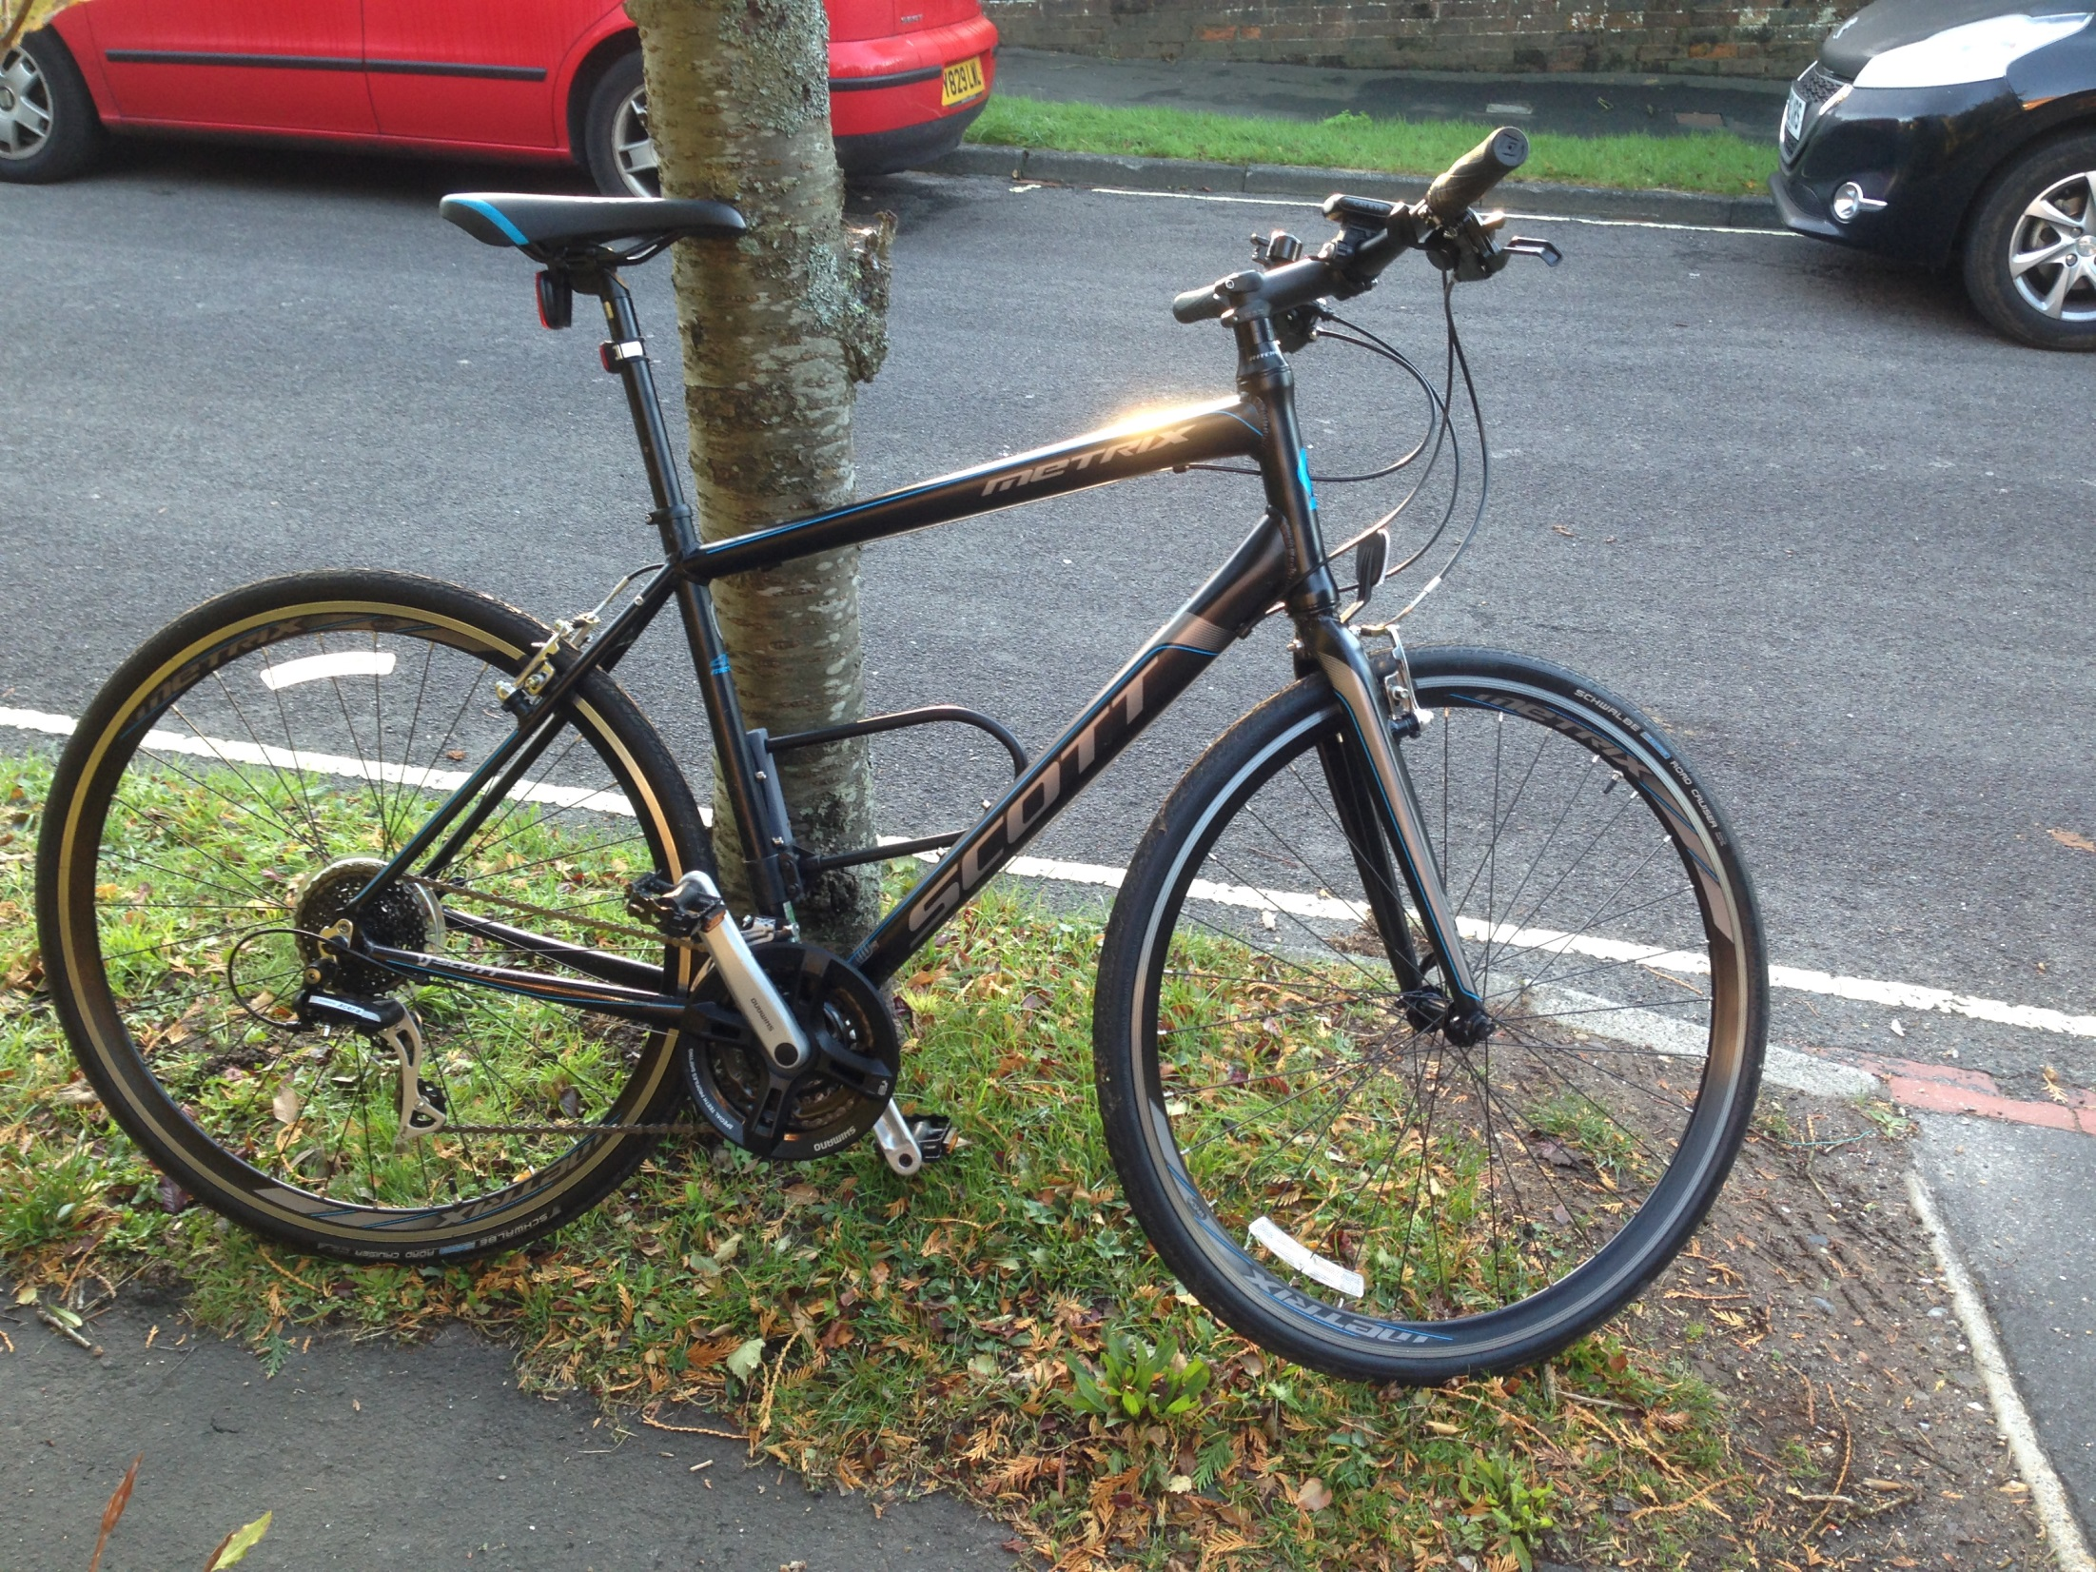
Notes:
Exercise – ride to work.. 35mins each way

Slide 69
Tooling
nCrunch
R#

Slide 70
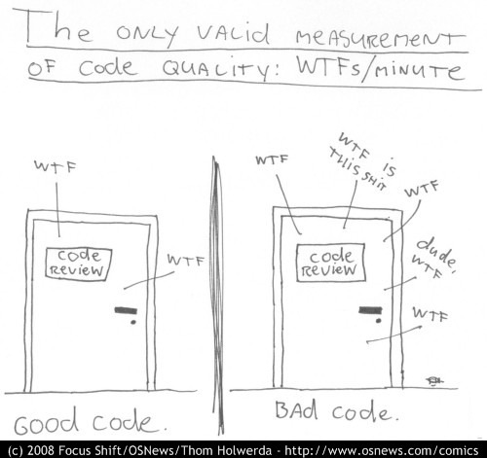
Notes:
7 Top Tips!
1 – Simplicity of code
Worked on rewrite of a project. Well architected Silverlight app, nice abstrations..commanding…
Too complex and over time, had become diluted. I think other devs didn’t understand it. Massive failure
I used Integration testing (200 tests for SL front end) and a very simple service architecture. EF for most of the CRUDing, and sprocs for the bits which needed optimisation

Slide 71
Simple HTML Helpers
AutoMapper
Merge and Create views
BDDness – ie tests named from customer point of view

Slide 72
0 – Source Control (Git)
1 – Start with customer ie tests (what you app does from customer point of view) and work backwards
7 – Azure support great.. Get app working end to end in production environement if possible (Azure)
2 – KISS (Keep it Simple).. IoC, UoW, ViewModels, AutoMapper needed??
3 – Composition over Inheritance
4 – Merge edit and create views
5 – Html ‘helpers’ – use html
6 – Enum support in 5.1

Slide 73
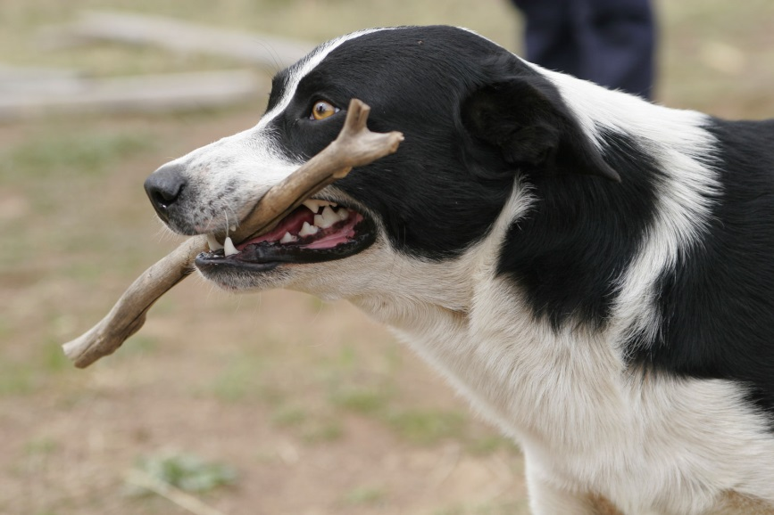
Thank you very much!
Enjoy programming ☺
Do it every day?
davemateer@gmail.com
All source and presentation on github.com/djhmateer/funny
www.davesjokes.co.uk

